Slide 1
Introduction – Wine dataset
Input variables based on physicochemical tests:
1) Fixed acidity: numeric, continuous - base level of acidity
2) Volatile acidity: numeric, continuous - varying level of acidity
3) Citric acid: numeric, continuous - measure of citric acid
4) Residual sugar: numeric, continuous - level of sugars
5) Chlorides: numeric, continuous - levels of chloride
6) Free sulfur dioxide: numeric, continuous - free particles, sulfur dioxide
7) Total sulfur dioxide: numeric, continuous - total sulfur dioxide
8) Density: category - liquid density rating
9) pH: numeric, continuous - pH level
10) Sulphates: numeric, continuous - sulphate count
11) Alcohol: numeric, continuous - percentage of alcohol
12) Kind: category - red or white wine

Slide 2
Introduction – clean_data()
One-hot encode the categorical data for later statistical analysis.
Red => 1 White => 0
Fill (numeric) missing values with numpy NaN value
missing_value => np.nan()
Replace the outliers (values beyond 3*σ)
x_{outlier} => mean + δ*σ , where δ is a random value between (0, 1)

Slide 3
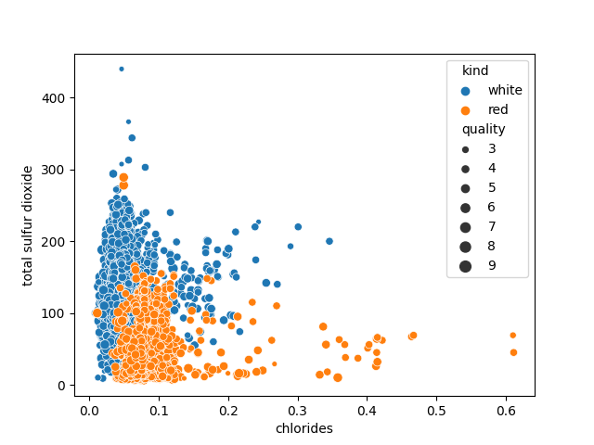
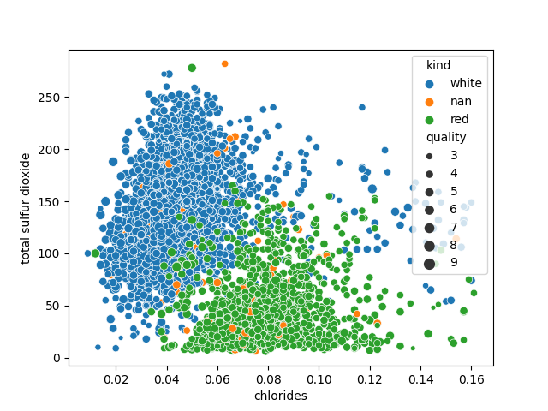
Introduction – clean_data()
clean_data()

Slide 4
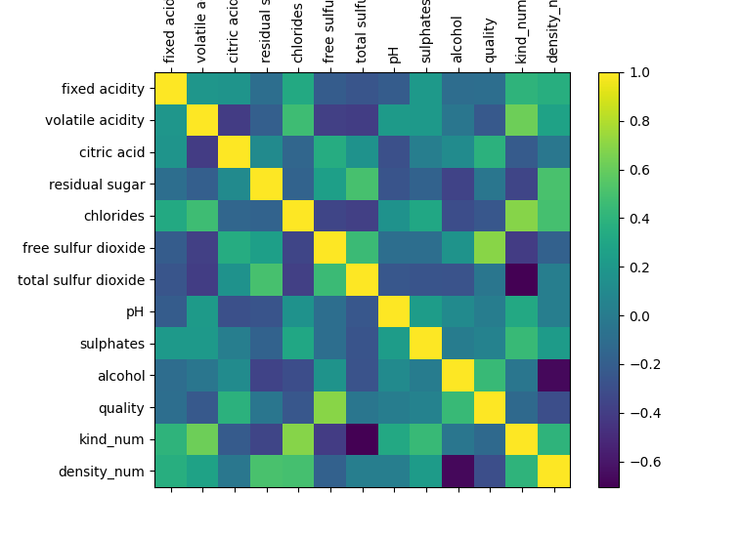
Data analysis – Correlation map
High correlation between:
Chlorides – Total Sulfur Dioxide
Kind – Total Sulfur Dioxide
Density – Alcohol
Quality – Free Sulfur Dioxide

Slide 5
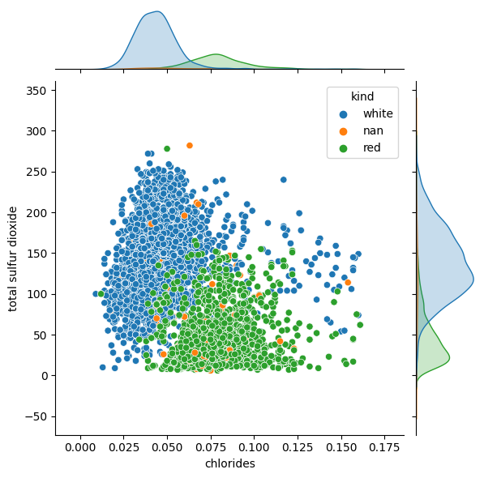
Data analysis – Kind correlation
We can see that the peak of the distributions are well separated by kind, wich means that there is a correlation between the kind and the other variables.

Slide 6
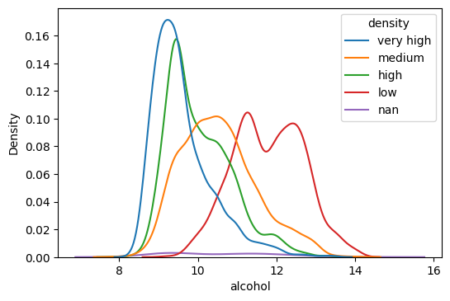
Data analysis – Quality correlation
We can see that there is a negative correlation, so the higher the alcohol in the wine, the lower it’s density.

Slide 7
Classification – Gaussian NB
Run a Gaussian-NB classifier with every pair of features.
Choose the pair that yielded the highest accuracy.
Result: chlorides and total sulfur dioxide (94.04% accuracy)
$$x→\frac{x−x_{mean}}{σ}$$
Observation:

Slide 8
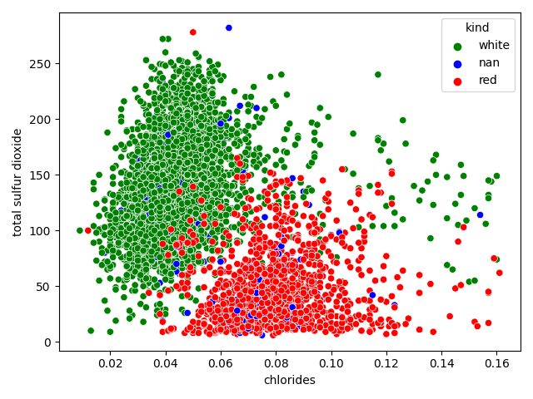
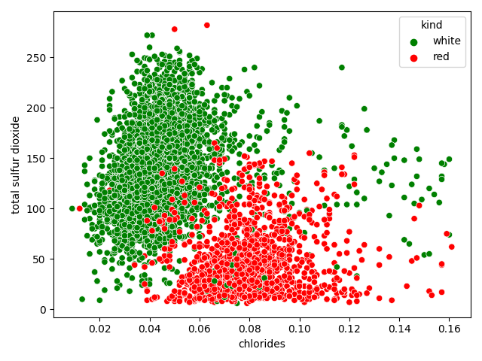
Classification – Gaussian NB
Gaussian NB

Slide 9
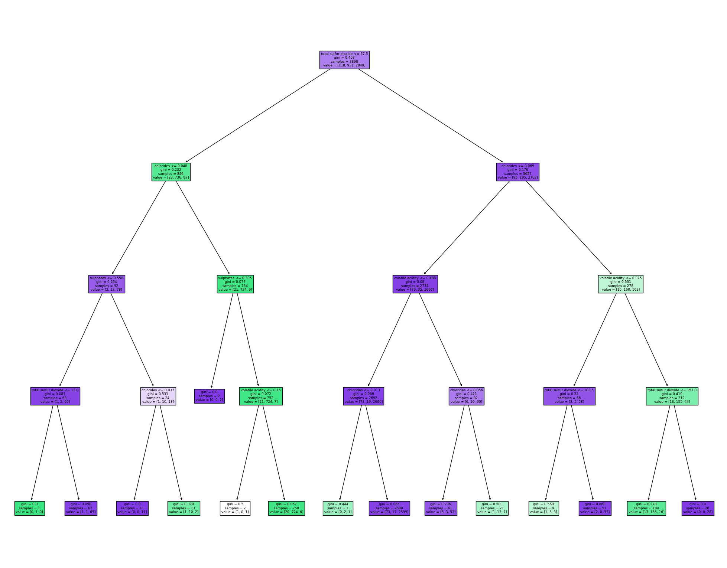
Classification – Decision Tree
Presicion with raw data: % 97.15
Presicion with clean data: % 95.15

